Slide 1
Lesson 1 -Data
Ben Schwarz

Slide 2


Lesson Outline
Overview of Data and Data Types
Variables
Using Data and variables

Slide 3
Data Types
Computer think in 1s and 0s (binary)
J – 01001010
Or for the number 74, 1.036960863003646x10⁻⁴³ or interpreted as screen pixels. This sequence can stand for whatever the computer interprets it to be.
How do we tell the computer what type of data it is -> type

Slide 4
Primitive Types
Java has eight primitive types:
Category | Type (Case Sensitive) | Size(bits) | Minimum Value | Maximum Value | Precision | Examples
Integer | byte | 8 | -128 | 127 | From +127 to -128 | 65, -34,
Integer | char | 16 | 0 | 2¹⁶-1 | All Unicode characters | ‘A’, 65, ‘B’
Integer | short | 16 | -2¹⁵ | 2¹⁵-1 | From +32,767 to -32,768 | 1, -5, 304, 9893
Integer | int | 32 | -2³¹ | 2³¹-1 | From +2,147,483,647 to -2,147,483,648 | 0, 43442, -443
Integer | long | 64 | -2⁶³ | 2⁶³-1 | From +9,223,372,036,854,775,807 to -9,223,372,036,854,775,808 | 65L
Floating point | float | 32 | 2⁻¹⁴⁹ | (2-2⁻²³)·2¹²⁷ | From 3.402,823,5 E+38 to 1.4 E-45 | 65f, 34.4f
Floating point | double | 64 | 2⁻¹⁰⁷⁴ | (2-2⁻⁵²)·2¹⁰²³ | From 1.797,693,134,862,315,7 E+308 to 4.9 E-324 | 53.53
Other | boolean |  |  |  | false, true | true

Slide 5
What is a variable
Computers are like people -> They do things, but they need to remember things to do things.
Variables are the computers way of remembering things.
Imagine a big storing wall, with labelled boxes which you can store objects (data) in.
Later you can go get the object (data) out of it and use it.
Each box is like a variable. Each variable has a name, and you address it by it’s name. You can store values in variables, and retrieve and do things with that value.

Slide 6
Making Variables
Three parts to a variable:
The type of variable (The data type)
The name of the variable – what you address it as.
The value of the variable – the data.
Convention for variable names is lowerCamelCase – start of each word capitalized, except for the first word.
Java is a strongly type language. Every variable has a type which can’t be changed. Other (hipster) languages like Python aren’t strongly typed – anything can go in any variable at any time.

Slide 7
Syntax Overview – Variables
“;” marks the end of an instruction/line of code
Variables
don’t exist until you create them (declaration)
don’t have a value until you first set it (initialisation)
have a fixed type
cannot be set implicitly
can be used as if they were the values they hold
can be set to different values as the program runs (assignment)
Declaration:
datatype variableName;
Assignment:
variableName = value2;
Declaration & Initialisation:
datatype variableName = value1;

Slide 8
Using Data - Operators
Computers do math(woah)
Java follows BODMAS when executing maths.
int teamNumber = 4613;
int randomBlackMagic = 1;
double aNumber = 1;
double myIQ = 5.3;
aNumber = randomBlackMagic*(aNumber+teamNumber-myIQ%2);
Operation Symbol | Operation
+ | Plus - Adds values
- | Subtract – minus values
* | Multiply – Multiply Values
/ | Divides values – Think as a fraction
() | Brackets – are completed first
% | Modulo operator – returns remainder of a division

Slide 9


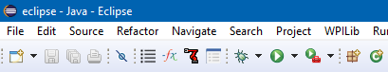
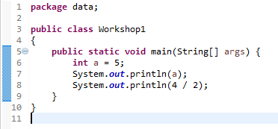
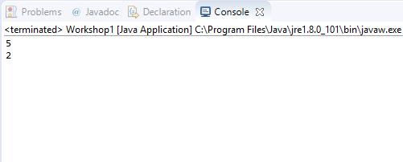
The System.out.println() Function
We can ‘print’ the value of basic variables using ‘System.out.println(variableName)’
This outputs the current value of the variable when we run the code by clicking the run icon in the toolbar.
We can also print expressions by putting them in the place of the variable name.

Slide 10
Exercises:
Create a program that prints the values of the following:
Integer “num”, set to 3
Double “dec”, set to -2.5
Double “dec2” set to 3
Double “decNew”, set to dec*dec2
Char “a” = ‘b’
Num*-dec/a + decNew+Num*5%dec
Create 2 variables – int currentNumber = 5 & int oldNumber = 3. Write code to swap their value so that currentNumber = 3 & oldNumber = 5.

Slide 11

Using Data – Comparisons: Syntax Overview
All datatypes have the comparative operators “==” and “!=”. We’ll learn later about some types where these don’t do what you expect, but you can assume consistent behaviour from them at the moment.
int, float/double
Comparative operators are “>=”, “<=”, “>”, “<“
boolean
All comparisons have a boolean result
This value can be stored as any other boolean
“comparison” has the same result as “comparison == true”
“!comparison” has the same result as “comparison == false”

Slide 12
Exercises:
Create a program that prints the values of the following:
The boolean result of whether num is equal to 3
The Boolean result of whether num2 > 5
The Boolean result of whether char ‘a’ – ‘b’ < 1
Why does this happen? This will be explained next lesson.
Create a Boolean “running” and set to true. Then print the Boolean result of “!running”
Create a program that prints the value of the circumference of a circle, given its radius, by also creating a constant for pi to 5 decimal places
For the second problem, putting the keyword “final” before the type when creating a variable makes it a constant, whose value cannot be changed:
final datatype variableName = value1;
3) Extension Question: for two given side lengths of a right-angled triangle, output the hypotenuse (You will need to google to find out how to get the square root of a number)

Slide 13
Lazy Tips and tricks
Often you will want to do certain things to a variable. Since we programmers are lazy, we have special Syntax to do these things quickly.
Table of Useful Shortcuts (Not all of them):
Operator | Description
+= | Add amount to variable
-= | Subtract amount to variable
*= | Times variable by amount
/= | Divide variable
%= | Modulus operator. Divides variable by a number, and sets variable to the remainder. (E.g. 10 % 3 = 1)
++ | Add one to a variable (e.g aNumber++;)
-- | Subtract one to a variable(e.g. aNumber--;)

Slide 14
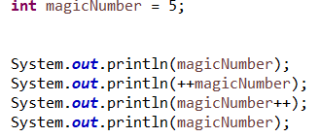
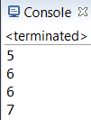
Consider the following code
Why does it act this way?

Slide 15
Homework
Redo the earlier problems – now using the shortcuts.
Output 5*(8-6/3)%2. Check your answer to make sure it is correct.
Compare if the question 2 formula is less than or equal to the result from the calculation for the circumference.
If you have done this all before:
1. Have someone input the hypotenuse of a right angle triangle and a angle(not being the 90) and tell them the other two sides and the opposite angle.
2. Write a program to return the factors of an int variable x.
Note: I suggest using Trigonometry. Make sure to read the documentation to understand how to use it and note that java uses radians and not degrees. So you will need to convert (the Math class has a function for this)

Slide 16
Summary:
You should now be able to create variables and constants to store numbers and Booleans.
Print outputs to a console window.
Do basic maths with a program, by giving it a set of inputs.
Do comparisons between different data to return a Boolean value.

